Slide 1
Efficient Web Searching:Navigating the Digital Landscape
Nacer bey
abderrahmane zakaria
8.12.2023

Slide 2
Plan
Introduction
Existing Search Engines
Statistics on Search Engines
Challenges in Web Search
Efficient Searching Techniques
Conclusion

Slide 3
Introduction
Why Efficient Web Search Matters
The internet contains an immense volume of diverse information, spanning articles, video, social media posts, and more. Quickly finding relevant information is crucial for several reasons:
Time efficiency: Rapid access to specific information saves time and enhacess productivity
Accuracy and Credibility: Quickly locating informations helps verify facts and ensures the use of accurate, reliable sources
Problem Solving:Quick access to information is crucial for troubleshooting and finding solutions to specific problems.
Decision-Making:Timely and relevant information is essential for making informed decisions in various contexts.
Innovation and Learning: Fast access to new ideas fosters innovation and accelerates the learning process
Competitive Edge: Individuals and organizations gain a competitive advantage by swiftly leveraging relevant information.
To navigate the vast web efficiently, effective search skills, advanced search operators,
and discernment about source credibility are essential.

Slide 4






2. Existing Search Engines
There were several popular search engines. Keep in mind the landscape may have changed since then. As of that time, some of the major search engines included:
Google: The most widely search engine globally, known for its speed and accuracy in delivering search results.
Bing: Microsoft’s search engine, offering a different approach and interface compared to Google.
Yahoo: While Yahoo has transitioned to using Bing's search results, it still maintains its search engine presence.
Baidu:The leading search engine in China, offering services in Chinese.
Yandex: A Russian search engine with a significant market share in Russia.
AOL Search: Although not as prominent as it once was, AOL still provides search services.
Remember that the popularity of search engines can vary by region, and new search engines may emerge over time. Additionally, the search engine landscape is dynamic, with changes and developments occurring regularly. Always check for the latest information to stay current.

Slide 5
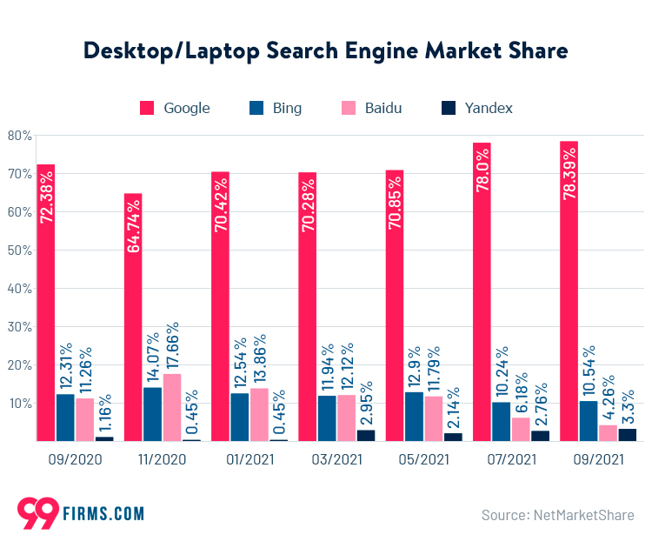
3. Statistics On Search Engines
Here are some statistics on search engines in January 2022:
Google:
Google remains the dominant search engine globally, with a market share of around 92% as of 2021.
Processes over 3.5 billion searches per day.
Bing:
Bing is the second-largest search engine with a global market share of around 2-3%.
Powers Yahoo's search results through a partnership.
Yahoo:
Yahoo's search market share is relatively small, and it relies on Bing for its search results.
Baidu:
Baidu is the leading search engine in China, holding over 70% of the market share in the country.
Yandex:
Yandex is the primary search engine in Russia, with a market share of around 60% in 2021.
AOL Search:
AOL Search has a very small market share compared to major search engines.

Slide 6
4. Challenge On Web Search
Select a Destination:
Choose a unique or off-the-beaten-path travel destination that you're not familiar with. It could be a remote island, a historical town, or an unconventional travel spot.
Craft Detailed Search Queries:
Develop a set of search queries to gather comprehensive information about the chosen destination. Include details such as local attractions, accommodations, transportation options, local cuisine, and any unique activities.
Use Multiple Search Engines:
Utilize at least three different search engines to gather information. Different search engines may provide varied perspectives and sources.
Consider User Reviews:
Look for user reviews on travel websites, forums, or social media platforms to gain insights from people who have visited the destination. Consider both positive and negative reviews for a well-rounded perspective.
Compile and Organize Information:
Compile all the information you've gathered and organize it in a way that is easy to reference. This could be a document, a spreadsheet, or a presentation.

Slide 7
5.Efficient Searching Techniques
Efficient search techniques are crucial for quickly and effectively finding the information you need on the web. Here are some tips to enhance your web searching efficiency:
Use Specific Keywords:
Be clear and specific about what you're looking for. Use relevant keywords that are likely to appear in the content you seek. Avoid vague or generic terms.
Use Quatation Mark:
Use quotation marks to search for an exact phrase. This is especially useful when you're looking for specific information or a quote.
Use Site-specific Searches:
If you want to search within a specific website or domain, use the "site:" operator. For example, "site:example.com" followed by your keywords will limit the search to that particular site.
Use Search Shortcuts:
Some search engines offer shortcuts for specific types of searches. For example, Google allows you to search for weather, definitions, calculations, etc., directly in the search bar.
Be Mindful of Search History:
Consider your previous search history. Sometimes, refining your search based on your past queries can lead to better results.

Slide 8
6. Coclusion
In conclusion, efficient web searching is a multifaceted skill that involves both technical aspects, such as using search operators and engines effectively, and critical thinking skills, such as evaluating sources and synthesizing information. Developing and refining these skills can empower individuals to navigate the vast sea of online information with confidence and accuracy.

